Slide 1
Lunch & Learn – JPA Inheritance
February 14, 2020
2/14/2020

Slide 2
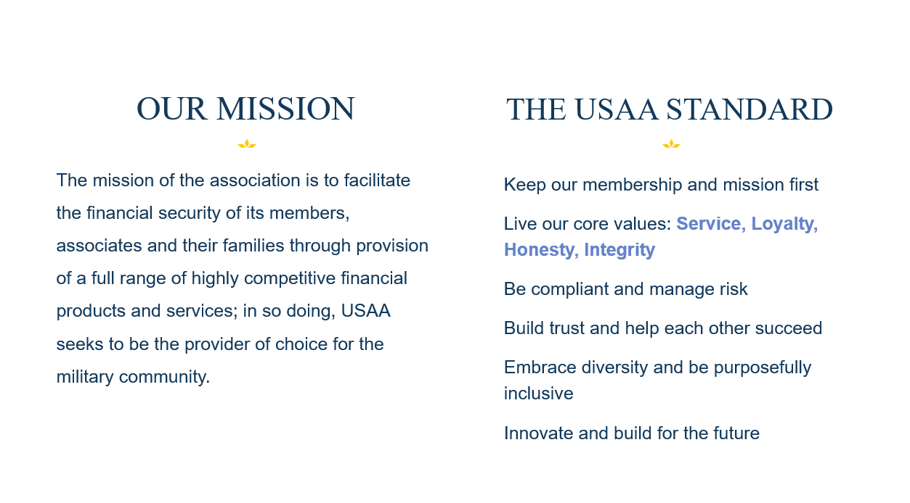

Slide 3
JPA Inheritance Polymorphic Queries
What is it?
Allows querying parent class to retrieve all children as well
Works when parent class is interface or class
Children can be excluded by annotating their entity with @Polymorphism(type = PolymorphismType.EXPLICIT)
Can be both good and bad
Notes:
Inheritance provides polymorphic query capabilities.
Querying parent class can return all sub
Allows querying parent class to retrieve all children as well

Slide 4
Why use JPA Inheritance?
Inheritance is key concept in Java and OOP
Object Oriented inheritance doesn’t translate well to relational DBs
SQL doesn’t have the concept of inheritance
Minizes writing of SQL
Polymorphic queries
Avoids repeated code
Notes:
Avoid repeating yourself in your entities
Inheritance provides polymorphic query capabilities.
Querying parent class can return all sub
Allows querying parent class to retrieve all children as well
Inheritance is key concept in Java
Object Oriented inheritance doesn’t translate well to relational DBs
SQL doesn’t have this concept
Think of a deep inheritance tree in SQL… (ouch)

Slide 5
Strategies Overview
JPA has Four Inheritance Strategies:
Mapped Super Class The parent class is not/cannot be a DB entity (no @Entity)
Table Per Class Each table has all properties of parent and siblings
Single Table Inheritance Different entities that have same parent all in one table
Joined Table Inheritance Each table has own table. Queries require join
Notes:
Each has their own advantages and disadvantages
Up to you to decide which best fits your need
Mapped Super - the parent class is not/cannot be a DB entity (no @Entity)
Table per class - each table has all the properties of a class in it’s own table so no join is required
Single Table - different entities that have common ancestor are all stored in a single table
Joined Table - each class with have it’s own table. Querying subclasses requires a table join

Slide 6
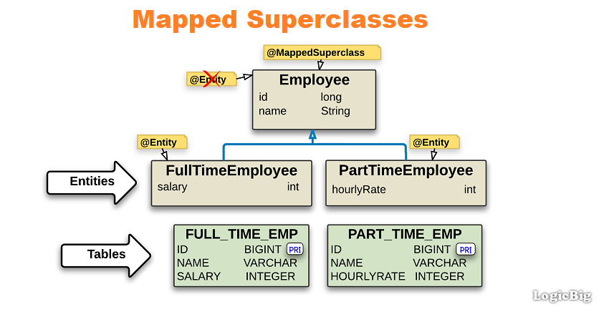
MappedSuperclass Overview
Notes:
Easiest approach
Parent class can only be extended, not instantiated
Parent is not an entity (no @Entity annotation)
Parent annotated with @MappedSuperClass
Children only need to extend the parent and use @Entity
Each child maps to it’s own concrete table

Slide 7
Mapped Super Class Inheritance Pros & Cons
Pros:
Allows you to share attributes between multiple entities
Notes:
Pros

Slide 8
Mapped Super Class Inheritance Pros & Cons
Cons:
Parent Class does not have a table associated
No relationships between child classes OOB
You will need to define relationships
You cannot use polymorphic queries
Notes:
Would either have to manually create a uni-directional relationship between each
Or create relationship between Parent to each Child
If you need that relationship for queries try another strategy

Slide 9
MappedSuperclass Example
See code...

Slide 10
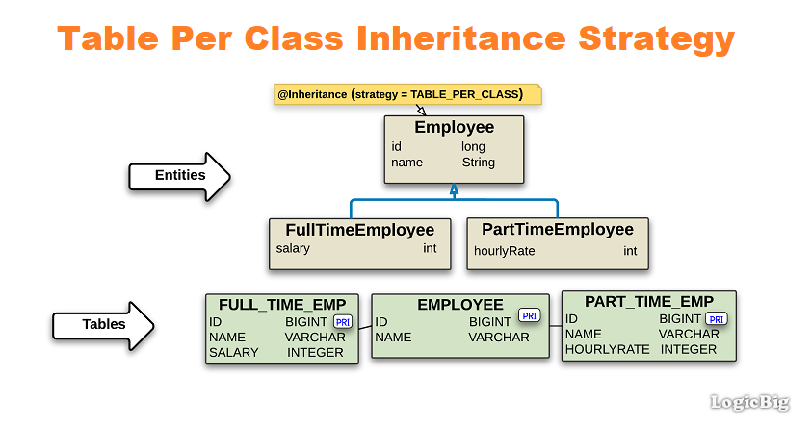
Table-Per-Class Overview
Notes:
Default for JPA
Similar to Mapped Super class
Key difference is that the parent is an entity
Each concrete entity is mapped to it’s own table
Each entities table will have the fields from the parent table
No annotation required for children
Children cannot define @Id field (inherits from parent)

Slide 11
Table Per Class Inheritance Pros & Cons
Pros:
Parent classes have instantiable entities
Allows for polymorphic queries
Parent classes have instantiable entities
Default inheritance strategy
Notes:
Pros

Slide 12
Table Per Class Inheritance Pros & Cons
Cons:
Uses SQL UNION when querying parent class (less efficient)
No identity key generation / specification by children
Polymorphic queries are more complex
Notes:
Pros

Slide 13
Table Per Class Inheritance Example
See code...

Slide 14
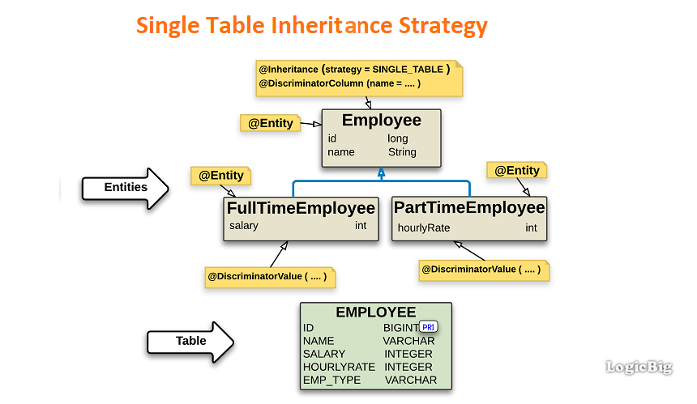
Single Table Inheritance Overview
Notes:
Creates single table for parent that includes all children into it
Annotate parent with @Inheritance( strategy = InheritanceType.SINGLE_TABLE)
JPA needs a way to discriminate between children. This is known as a Discriminator Value.
Defaults to column named DTYPE in table, but you can customize it via @DiscriminatorColumn an
Children annotate themselves with a discriminator value to set this @DiscriminatorValue annotation
If you don’t annotate JPA / Hibernate will supply it’s own values to the DTYPE field

Slide 15
Single Table Inheritance Pros & Cons
Pros:
Allows polymorphic queries
Easy and efficient
All entities stored in same table
No table joins required
JPA easily generates required SQL for queries
Notes:
Pros
Easy and efficient
All entities in single table so queries between children are in same table
No table joins required
Cons

Slide 16
Single Table Inheritance Pros & Cons
Cons:
Polymorphic queries… double edged sword
Table size grows with number of children
Cannot use @NotNull constraints on sub-class entity properties
Notes:
Cons
Can’t use @NotNull for subclass fields. Can’t be null

Slide 17
Single Table Inheritance Example
See code...

Slide 18
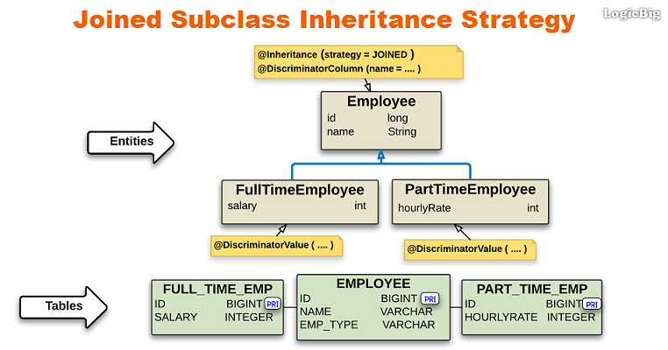
Joined Table Inheritance Overview
Notes:
Similar to the table per class strategy because
Each child entity has it’s own table
Each child doesn’t require to be annotated
Difference is that the parent has it’s own table, which contains it’s own fields and id field
This id field is shared down the it’s children at creation time as a foreign key constraint

Slide 19
Joined Table Inheritance Pros & Cons
Pros:
Tables are smaller because they only contain their own fields
Allows for @NotNull (nullable) fields in children
Joined fields are already defined
Join will only consist of two tables
No special annotation required for children
Only identifier field is repeated
Notes:
Pros

Slide 20
Joined Table Inheritance Pros & Cons
Cons:
Have to join tables for polymorphic queries
Less efficient
When querying the parent class number of joins goes up as it will join for each child
Notes:
Cons
Still need to perform table join

Slide 21
Joined Table Inheritance Example
See code...

Slide 22
JPA Inheritance Conclusion
Choosing a Strategy
Best performance with polymorphic queries and relationships: Single Table Strategy
Data consistency with polymorphic queries is more important than performance: Joined Strategy
Polymorphic queries or relationships and data consistency : Table per Class
Notes:
Not an easy decision
Consider pros and cons and decide what cons you are will to accept
Best Perm: Single table -> don’t forget cons: can’t use notnull constraints in subclasses. Risk of data inconsistencies
Table per class -> don’t forget the cons: poly queries are complex

Slide 23
JPA Inheritance
Questions?

Slide 24
JPA Inheritance
APPLAUSE!!!!

